Slide 1

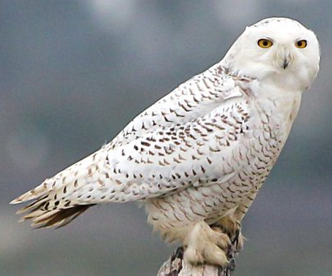
algo-owls
Team Members:
Christian –
Underlying strategy
Jonathan –
Project Plan
Carolina –
Random Forest Metrics
Mark –
LSTM Metrics
January 16th 2021

Slide 2
The Strategy
We aim at anticipating market moves by identifying squeezes that precedes them.
We aim at using 2 EMAs crossovers to anticipate their crossovers for direction predictions.

Slide 3
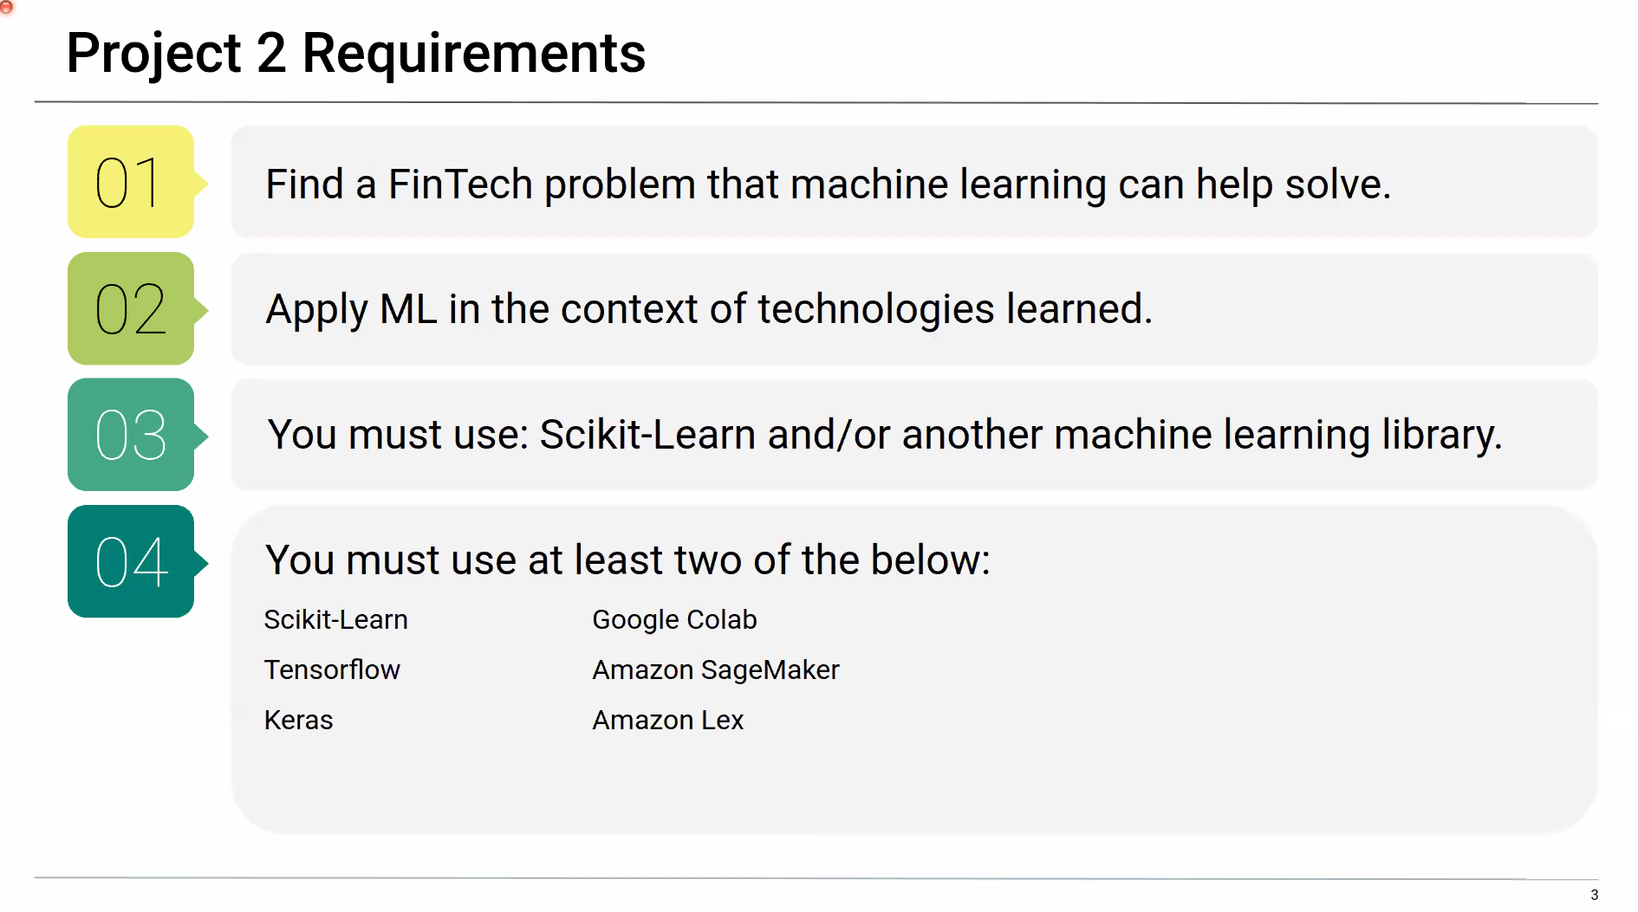
Project Objectives
REQUIREMENTS
OUR SCOPE OF WORK
Build one Machine Learning Model to predict the squeeze breakout and breakout direction.
Use at least two of the libraries specified below:

Slide 4
Project Objectives
REQUIREMENTS
OUR SCOPE OF WORK
Build one Machine Learning Model to predict the squeeze breakout and breakout direction.
Use at least two of the libraries specified below:
Build a Machine Learning system comprised of 4 Machine Learning Models:
2 Random Forests Classifiers (squeeze and EMAs crossover)
1 LSTM Binary
1 LSTM price predictor (price entry)

Slide 5
Project Objectives
REQUIREMENTS
OUR SCOPE OF WORK
Build one Machine Learning Model to predict the squeeze breakout and breakout direction.
Use at least two of the libraries specified below:
Build a Machine Learning system comprised of 4 Machine Learning Models:
2 Random Forests Classifiers (squeeze and EMAs crossover)
1 LSTM Binary
1 LSTM price predictor (price entry)
Analyze each ML Performance with analytics and metrics.
Libraries and applications:
Scikit-Learn
TensorFlow
Keras
Google Colab

Slide 6
PROJECT PLAN
Mod 2:
Feat_func
python
Mod 1:
Data_imp.

Slide 7
PROJECT PLAN
Mod 3:
Feat_func
Python 2
Mod 2:
Feat_func
python
Mod 1:
Data_imp.

Slide 8
PROJECT PLAN
Mod 4:
Feat_func
& y_gene
TS
Mod 3:
Feat_func
Python 2
Mod 2:
Feat_func
python
Mod 1:
Data_imp.

Slide 9
csv input
PROJECT PLAN
Mod 4:
Feat_func
& y_gene
TS
Module 5:
RF for squeeze
Module 6:
RF for Ema’s
Mod 3:
Feat_func
Python 2
Mod 2:
Feat_func
python
Mod 1:
Data_imp.

Slide 10
csv input
PROJECT PLAN
Mod 4:
Feat_func
& y_gene
TS
Module 5:
RF for squeeze
Module 6:
RF for Ema’s
Mod 3:
Feat_func
Python 2
Selective Function
Module 7
LSTM binary
Mod 2:
Feat_func
python
Mod 1:
Data_imp.

Slide 11
csv input
PROJECT PLAN
Mod 4:
Feat_func
& y_gene
TS
Module 5:
RF for squeeze
Module 6:
RF for Ema’s
Mod 3:
Feat_func
Python 2
Selective Function
Module 7
LSTM binary
Mod 2:
Feat_func
python
Module 8
LSTM price entry
Mod 1:
Data_imp.

Slide 12
csv input
PROJECT PLAN
Mod 4:
Feat_func
& y_gene
TS
Module 5:
RF for squeeze
Module 6:
RF for Ema’s
Mod 3:
Feat_func
Python 2
Selective Function
Module 7
LSTM binary
Mod 2:
Feat_func
python
Module 8
LSTM price entry
Module 10:
Automation
And ML integration
Mod 1:
Data_imp.
Module 9
LSTM price target

Slide 13
csv input
PROJECT FINAL
Mod 4:
Feat_func
& y_gene
TS
Module 5:
RF for squeeze
Module 6:
RF for Ema’s
RF’s trained & tested
Mod 3:
Feat_func
Python 2
.PY script
Selective Function
Mod 2:
Feat_func
python
Module 8
LSTM price entry
Mod 1:
Data_imp.

Slide 14
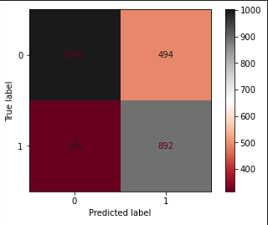
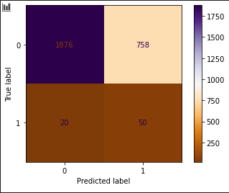
Random Forest Metrics
Module 5: Squeeze RF
Module 6: EMAs cross RF
Estimators = 1000
Max_depth =20
Relevant Features 53%: ema_dist, delta, close, ATR and high.
Acc. Score: 71%
Acc. Score: 70%
Estimators = 1000
Max_depth =25
Relevant Features 60%: bbup, bblo, kcup, kclo and 20sma.

Slide 15
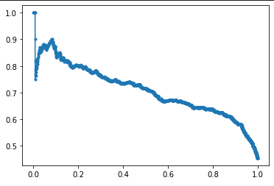
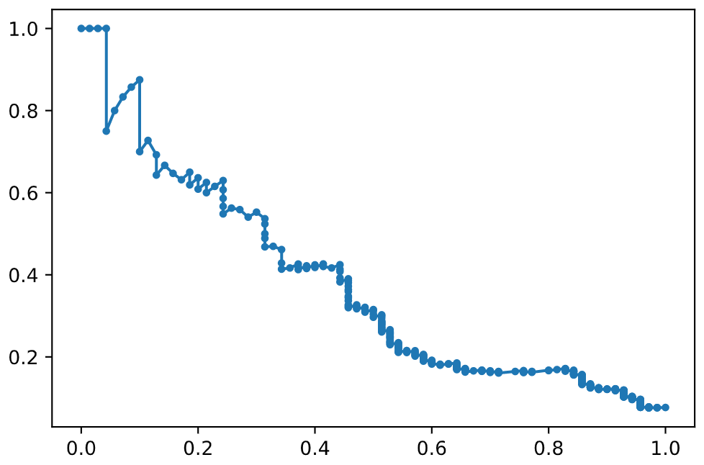
Random Forest Metrics
Module 5: Squeeze RF
Module 6: EMAs cross RF
Precision
Precision
Recall
Recall
Precision Recall Curve

Slide 16
Random Forest – Importance Features
%

Slide 17
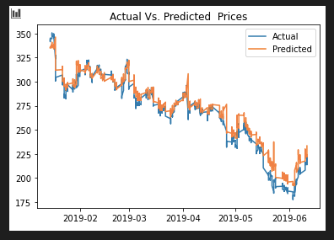
LSTM Metrics
Module 8: Price Entry
USD
Dates
Loss function = 0.00205

Slide 18
Future Developments
Automation / Machine Learning integration
Develop a .py script using Select Function
Develop a Machine Learning Model to predict prices 5 or more periods ahead (target price predictor)
Develop Function that execute trades based on prices forecasted by LSTM price predictors.

Slide 19
Summary
LSTM binary model caused barriers to the Machine Learning system.
The two random forest classifiers offered 70% or above accuracy score.

Slide 20
algo-owls

Slide 21
algo-owls

Slide 22
Random Forest Metrics
Module 5: Squeeze RF
Module 6: EMAs cross RF
Estimators = 1000
Max_depth =20
Relevant Features 53%: ema_dist, delta, close, ATR and high.
Acc. Score: 71%
Acc. Score: 70%
Estimators = 1000
Max_depth =25
Relevant Features 60%: bbup, bblo, kcup, kclo and 20sma.

Slide 23
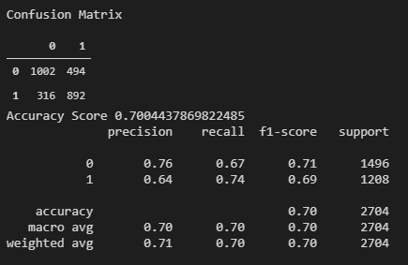
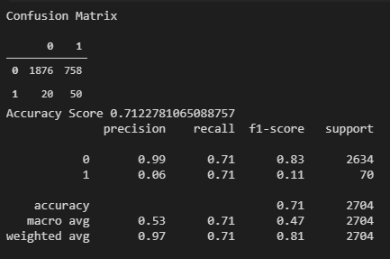
Random Forest Metrics
Module 5: Squeeze RF
Module 6: EMAs cross RF
Precision
Precision Recall Curve
Recall
Precision
Recall

